Slide 1

CMOS VLSI Design Topic – Logical Effort
By
Dr.Rohit Lorenzo
Assistant Professor Sr. Grade -1
School of Electronics Engineering (SENSE)

Slide 2
Topic – Logical Effort Talk Outline
Introduction
Delay in logic gate
Multistage Logic Networks
Example
Summary

Slide 3
Introduction
Chip designer face number of choices like –
What is the best topology for a function?
How many stage of logic gives best function?
How wide should the transistor be?
Logical effort is a method to take decisions -
Uses a simple model of delay.
Helps make rapid comparisons between alternatives.
Emphasizes remarkable symmetries.

Slide 4
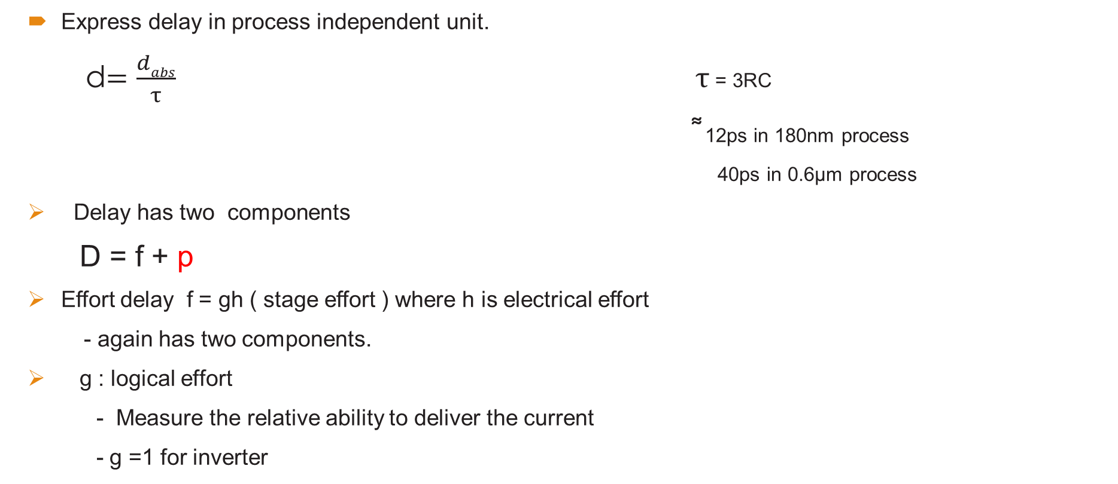
Delay in a logic gate.
Express delay in process independent unit.
d$=\frac{dabs}{τ}$ $τ$ = 3RC
͌ 12ps in 180nm process
40ps in 0.6µm process
Delay has two components
D = f + p
Effort delay f = gh ( stage effort ) where h is electrical effort
- again has two components.
g : logical effort
- Measure the relative ability to deliver the current
- g =1 for inverter

Slide 5
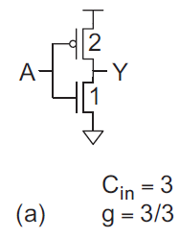
Computing logical effort
Definition: The Logical effort is the ratio of the input capacitance of the gate to the input capacitance of an inverter delivering the same output current.
Inverter
Logical Effort of basic gate g = C_{in}gate/C_{in}inverter
C_{in}inverter = 2unit + 1Unit = 3Unit

Slide 6
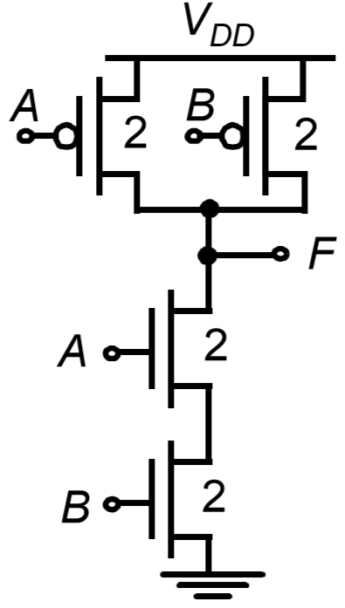
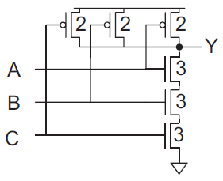
Continue …
2 input NAND gate
C_{in} NAND2 = 2unit(NMOS) + 2 unit(PMOS) = 4 Unit
The NAND presents 4units of capacitance on each input.
g = C_{in}gate/C_{in}inverter = 4/3
3 Input NAND Gate
C_{in} NAND3 = 3unit(NMOS) + 2 unit(PMOS) = 5 Unit
The NAND presents 5units of capacitance on each input.
g = C_{in}gate/C_{in}inverter = 5/3
^{G for NAND Gate}
(n+2)/3 , where n is number of inputs

Slide 7
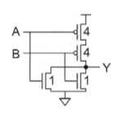
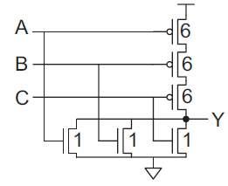
Continue…..
2 input NOR gate
C_{in} NOR2 = 1unit(NMOS) + 4unit(PMOS) = 5 Unit
The NOR presents 5units of capacitance on each input.
g = C_{in}gate/C_{in}inverter = 5/3
3 Input NOR Gate
C_{in} NOR3 = 1unit(NMOS) + 6unit(PMOS) = 7Unit
The NOR presents 5units of capacitance on each input.
g = C_{in}gate/C_{in}inverter = 7/3
^{G for NOR Gate}
(2n+1)/3 , where n is number of inputs

Slide 8
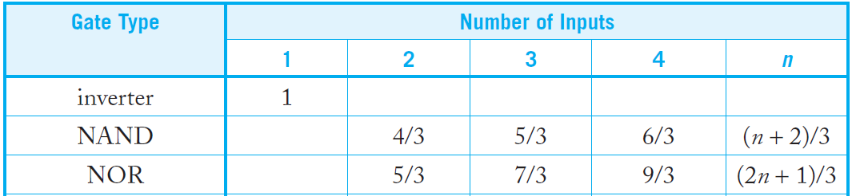
Logical Effort of Common gate

Slide 9
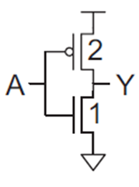

Parasitic Delay
P – parasitic delay
Represents delay of gate driving no load.
Set by internal parasitic capacitance.
P $=\frac{Cint Gate}{Cint INV}$
Inverter
C_{int} INV = 3
P $=\frac{3}{3}$ =1

Slide 10

Continue….
P (NAND2)
C_{in} NAND2 = 2+2+2 = 6
P $=\frac{Cint NAND2}{Cint INV}$ = $\frac{6}{3}$ = 2
P (NOR3)
C_{in} NOR3 = 6+1+1+1 = 9
P $=\frac{Cint NOr3}{Cint INV}$ = $\frac{9}{3}$ = 3

Slide 11
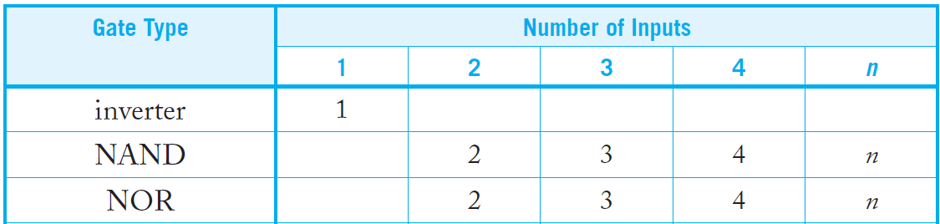
Parasitic Delay of Common Gate

Slide 12
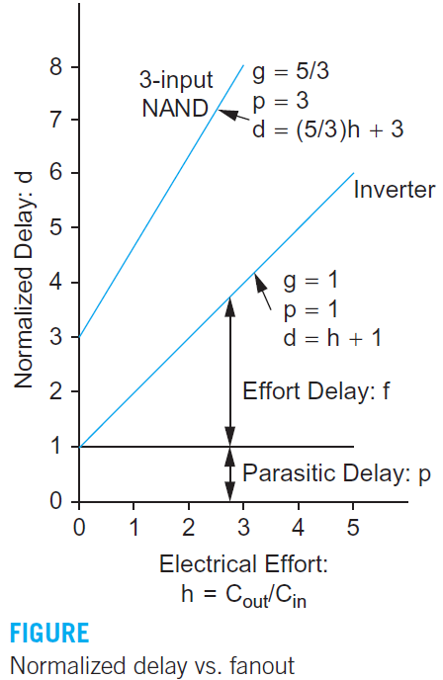
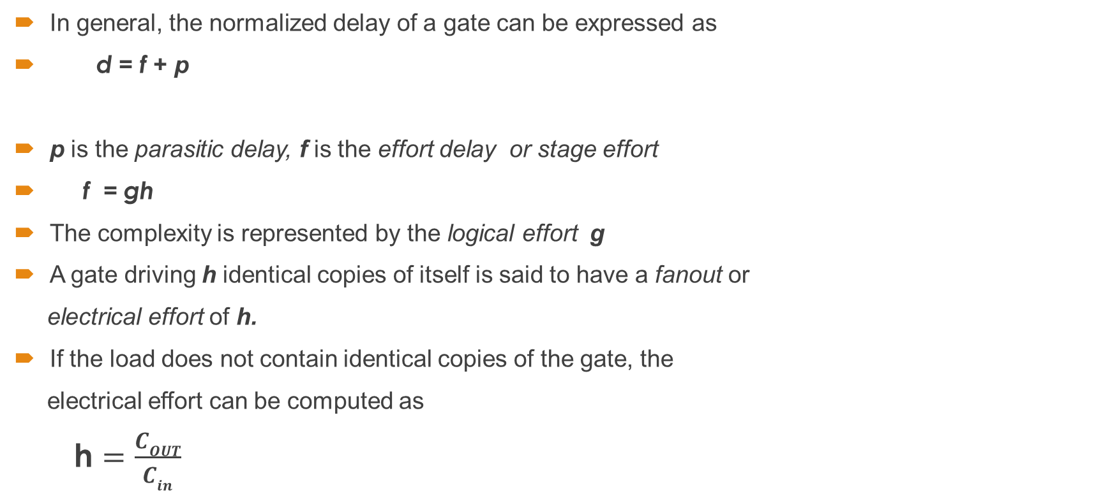
Linear Delay Model
In general, the normalized delay of a gate can be expressed as
d = f + p
p is the parasitic delay, f is the effort delay or stage effort
f = gh
The complexity is represented by the logical effort g
A gate driving h identical copies of itself is said to have a fanout or
electrical effort of h.
If the load does not contain identical copies of the gate, the
electrical effort can be computed as
h $=\frac{COUT}{Cin}$

Slide 13
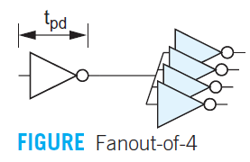

Problem
Q) Use the linear delay model to estimate the delay of the fanout-of-4 (FO4) inverter . Assume the inverter is constructed in a 65 nm process with $τ$ = 3 ps?
Solution
The logical effort of the inverter is g = 1, by definition. The electrical effort is 4 because the load is four gates of equal size. The parasitic delay of an inverter is p_{inv} =1. The total delay is d = gh + p = 1 × 4 + 1 = 5 in normalized terms, or t_{pd} = 15 ps in absolute terms.

Slide 14
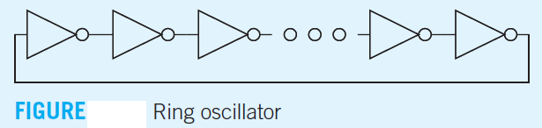
Problem
Q) A ring oscillator is constructed from an odd number of inverters, as shown in Figure . Estimate the frequency of an N-stage ring oscillator.?
Solution
The logical effort of the inverter is g = 1, by definition. The electrical effort of each inverter is also 1 because it drives a single identical load. The parasitic delay is also 1. The delay of each stage is d = gh + p = 1 × 1 + 1 = 2. An N-stage ring oscillator has a period of 2N stage delays because a value must propagate twice around the ring to regain the original polarity. Therefore, the period is T = 2 × 2N. The frequency is the reciprocal of the period, 1/4N.

Slide 15




Logical Efforts in Multi-Stage Logic Network
Logical effort ensures to get least overall delay by balancing the delay among stages .
The logical effort along a path compounds by multiplying the logical efforts of all the logic gates
The path logical effort G can be expressed as the products of the logical efforts of each stage along the path.
The path electrical effort H
The path effort F is the product of the stage efforts of each stage. Recall that the stage effort of a single stage is f = gh.
If a path has N stages and each bears the same effort, that effort must be

Slide 16
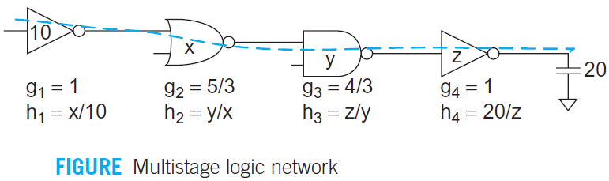
Example
Figure shows the logical and electrical efforts of each stage in a multistage path as a function of the sizes of each stage. Observe that logical effort is independent of size, while electrical effort depends on sizes.

Slide 17
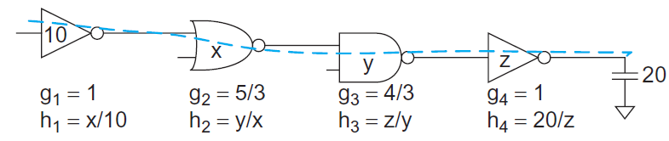

Problem
Q) Calculate the size of each gate?
Solution
H $=\frac{C_{out}}{C_{in}}$= $\frac{20}{10}$
G = $g_{1}$ ${×g}_{2}$ ${×g}_{3}$ ${×g}_{4}$ = $1×\frac{5}{3}×\frac{4}{3}×$1= $\frac{20}{9}$

Slide 18

Continue….
P = $P_{1}+P_{2}+P_{3}+P_{4}=1+2+2+1=6$
D = f + P
D = GH +P = $\frac{20}{9}×2+6=10.44$
F = GH = $\frac{20}{9}×2=4.44$
N = 4
F = $f^{N}$
f=1.451

Slide 19

Continue….
$f_{4}=g_{4}$× $h_{4}$
$g_{4}$= 1 , $f_{4}$=1.451 , $h_{4}$= $\frac{f_{4}}{g_{4}}$ = $\frac{1.451}{1}$
$h_{4}$= $\frac{20}{Z}$ , Z= $\frac{20}{1.45}$=13.79
------------------------------------------------------
$f_{3}=g_{3}$× $h_{3}$
$g_{3}$= $\frac{4}{3}$ , $f_{3}$=1.451 , $h_{3}$= $\frac{Z}{Y}$
Y=12.67

Slide 20
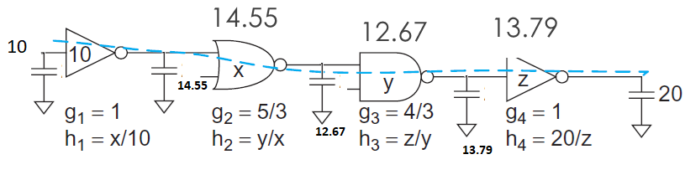

Continue…
$f_{2}=g_{2}$× $h_{2}$
$g_{2}$= $\frac{5}{3}$ , $f_{2}$=1.451 , $h_{2}$= $\frac{Y}{X}$
X = 14.55

Slide 21



Branching Effort
This branching effort b is the ratio of the total capacitance seen by a stage to the capacitance on the path.
The path branching effort B is the product of the branching efforts between stages.
we can define the path effort F as the product of the logical, electrical, and branching efforts of the path

Slide 22
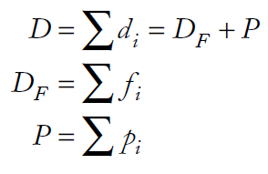

Continue…
The path delay D is the sum of the delays of each stage. It can also be written as the sum of the path effort delay D_{F} and path parasitic delay P.
If a path has N stages and each bears the same effort, that effort must be
the minimum possible delay of an N-stage path with path effort F and path parasitic
delay P is

Slide 23
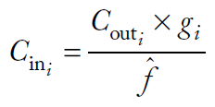

Continue…
f= gh
h = $\frac{C_{outi}}{ C_{ini}}$
Combining gives us the capacitance transformation formula to find the best input capacitance for a gate given the output capacitance it drives.

Slide 24
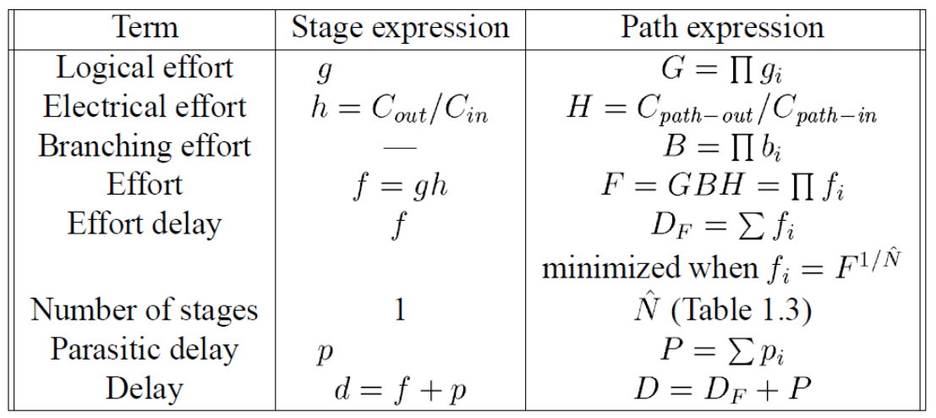
Summary

Slide 25
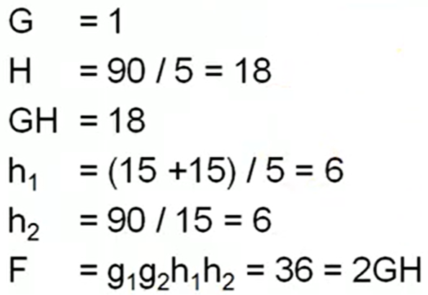
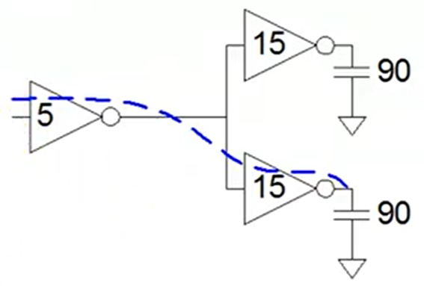
Path branch
Q Calculate path effort (F) of a given circuit?

Slide 26
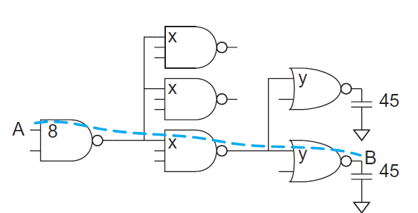
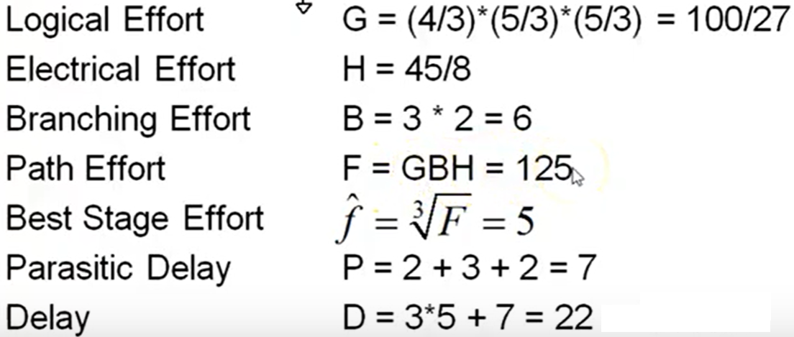
Problem
Q) a) Estimate the minimum delay of the path from A to B
b) Choose the transistor size to achieve this delay.
Solution (a)

Slide 27
Continue…
Solution b
The gate sizes are computed with the capacitance transformation from working backward along the path
y = 45 × (5/3)/5 = 15
x = (15 + 15) × (5/3)/5 = 10

Slide 28
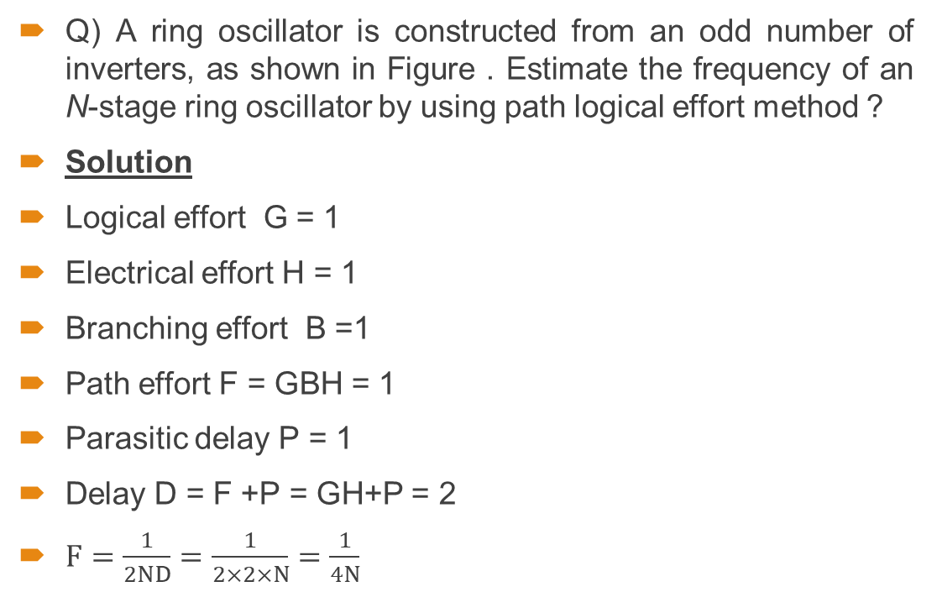
Problem
Q) A ring oscillator is constructed from an odd number of inverters, as shown in Figure . Estimate the frequency of an N-stage ring oscillator by using path logical effort method ?
Solution
Logical effort G = 1
Electrical effort H = 1
Branching effort B =1
Path effort F = GBH = 1
Parasitic delay P = 1
Delay D = F +P = GH+P = 2
$F=\frac{1}{2ND}=\frac{1}{2×2×N}=\frac{1}{4N}$

Slide 29
Derivation for least possible delay for a logic block
Consider the circuit containing n number of stages, n1 is the number of stages are in the logic block and N-n1 are the extra inverters. Least delay for the logic path will be
The first term is the delay obtained by distributing effort equally among the stage. The second term is the parasitic delay of the logic stages, and the third term is the parasitic delay of the inverters

Slide 30

Best stage effort
Differentiating this expression with respect to N and setting the result to zero, we obtain:
Let us define N is the number of stages and $ρ=F^{1/N}$ be the effort borne by each stages . The solution of the equation can be expressed as
Equation has no closed for solution
For Pinv = 1 the value of ρ = 3.59.
Therefore, the best stage effort will be nearly 4.

Slide 31
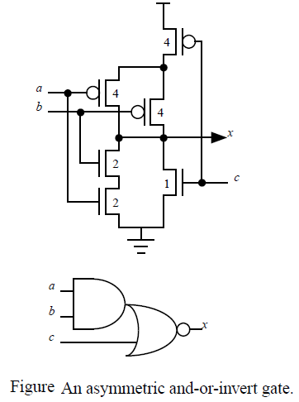

Asymmetric logic gates
we will analyze an example in which the logical effort differs for different inputs.
For example x= $\overline{ab+c}$
AND –OR-INVERT
The logical effort per unit input
A $\frac{4+2}{3}$=2
B $\frac{4+2}{3}$=2
C $\frac{4+1}{3}$= $\frac{5}{3}$
Total Logical effort = 2+2+$\frac{5}{3}$ = $\frac{17}{3}$

Slide 32
Thank You

